Slide 1


구분 | 내부 / 고객제출용
보안등급 | 1등급
화면설계서
SC-2220-화면설계서(외국어홈페이지)
V1.0
한국공예디자인문화진흥원 홈페이지 개편
단계 | 설계
구분 | 구축 단계별 산출물
2019.11.09
(주)유앤피플의 사전 승인 없이 본 내용의 전부 또는 일부에 대한 복사, 전재, 배포, 사용을 금합니다.

Slide 2
개 정 이 력
버전 | 변경일 | 변경사유 | 변 경 내 용 | 작성자 | 승인자
1.0 | 2018.10.30 | 최초 작성 |  | 조장혁 | 조성현
1.1 | 2018.11.01 | 회의내용 반영 | 콘텐츠 수정 | 조장혁 | 조성현
1.2 | 2018.11.09 | 회의내용 반영 | 콘텐츠 수정 | 조장혁 | 조성현
* 문서 버전 : 최초 버전은 1.0으로 시작하되, 변경 사항이 오류수정 등 미비할 경우 소수점 자리, 내용 추가 등 중대한 변경이 발생한 경우는 정수 자리의 버전 번호 증가로 구분
* 변경 사유 : 최초작성/내용수정/내용추가/내용삭제로 구분하여 기입

Slide 3
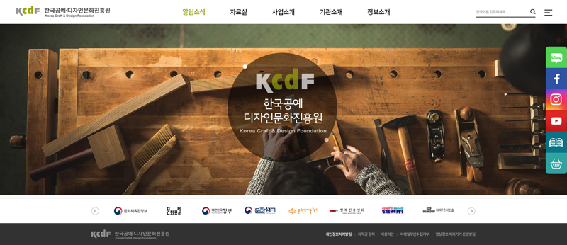
외국어 홈페이지 메인
Business About KCDF
KCDFE_Main
KCDF
외국어홈페이지 메인 비쥬얼 영역은 국문 홈페이지 비쥬얼과 연동하여 표시
배너는 국문홈페이지와 메인페이지의 배너 연동하여 활용
Korea
Craft & Design
Foundation
(03060)53, Yulgok-ro, Jongno-gu, Seoul, Republic of Korea (Tel: 82-2-389-7900)
Copyright C KCDF. All Reserved
LINK & DESCRIPTION
1
2
3
4
5
6
7
8

Slide 4
사업대분류1
Home > Business> Craft
사업소개
KCDFE_01
사업명1 | 사업명2 | 사업명3 | 사업명4
사업명5 | 사업명6 | 사업명7 | 사업명8
1
관리자에서 BBS 형식으로 등록
사용자 화면은 별도의 디자인을 진행하여 데이터 표시
사업대분류는
Craft
Design
Han-bok
Curture Station Seoul 284
※ 사업명
- Business Purpose
IMG
공예문화산업 종사자들과 소비자가 함께 만나는 최대 규모의 공예 전문 박람회로 차세대 공예작가 발굴 및 인큐베이팅을 통해 공예산업 활성화....
- Business Period
LINK & DESCRIPTION
1 | 등록 시 제목을 탭으로 표시하여 생성 탭 클릭 시 상세내용이 하단에 표시되도록 개발
2
3
4
5
6
7
8
YYYY-MM-DD ~ YYYY-MM-DD
- Supported
IMG
공예작가, 업체, 국내외 관련기관, 갤러리, 대학 등
다음페이지에 계속

Slide 5
이전페이지에 계속
사업소개
- 사업내용
KCDF_03_V
IMG
관리자에서 BBS 형식으로 등록
사용자 화면은 별도의 디자인을 진행하여 데이터 표시
전시 : 주제관 브랜드관 창작공방관, 대학관
부대행사 ; 세미나, 워크숍, 참여작가의 밤
지원서비스 : 비지니슥육, 바이어 매칭, 도슨트 투어, 현장 이벤트 등
- Schedule
1. 1분기 : 18년 참여업체 모집 및 심사
2. 2분기 : 참가자 대상 설명회.....
- Business History
2006.12 - 제1회 공예트렌드페어 개최
:
2015.12 - 제 10회 공예트렌드페어 개최
:
2017.11 -
LINK & DESCRIPTION
1
2
3
4
5
6
7
8
- Homepage
홈페이지) https://www.kcdf.kr/craftrendfair2016/main/craftfair2016Main/main.do
인스타그램) https://www.instagram.com/crafttrendfair/
Contact us
공예산업팀: T. 02-398-7952 E.<shhong@kcdf.kr>

Slide 6
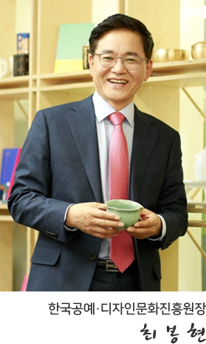
About KCDF
Home > About KCDF
인사말
KCDF_04_01_V
President Message | Establishment & History | Mission & Vision | Organization Chart
“The Korea Craft and Design Foundation (KCDF) leads
the excellence of Korea’s culture in craft, design and
hanbok (Korea’s national costume).”
The Korea Craft and Design Foundation (KCDF) is the main body that promotes the
craft and design culture of Korea. The objective is to improve people’s way of life
through Korea’s rich cultural heritage in craft and design. For many years we have
focused on promoting our cultural assets both inside Korea and also internationally.
Cultural marketing is the future in terms of contributing to the national economy
and many of our projects are aimed toward this goal. We organize exhibitions
domestically and internationally, promote young makers and develop craft and
design related products. We work across many boundaries from artistic expressions,
reinterpreting traditional skills, researching on craft materials, preserving cultural
heritage and developing entrepreneurship.
Our mission is to communicate with people through craft, design and hanbok. We
believe that culture is the main platform for enriching people’s lifestyle and for
developing exchanges to share creative ideas
Thank you!
HTML 콘텐츠
LINK & DESCRIPTION
1
2
3
4
5
6
7
8
Bonghyun CHOI
President
Korea Craft & Design Foundation

Slide 7
About KCDF
Home > About KCDF
설립목적
KCDF_04_02_01_V
President Message | Establishment & History | Mission & Vision | Organization Chart
Establishment
The Korea Craft & Design Foundation is a public organization affiliated to the Korean Ministry of Sports, Culture and Tourism. The objective of the organization is to promote Korea’s craft, design and hanbok both in Korea and internationally. It is our responsibility to promote the field in order to create opportunities for young makers, artists and related groups. We focus on preserving our own cultural heritage by re-interpreting tradition, research on
craft materials/skills and also developing craft related regions around the country. We have worked to improve competition in the field additionally as building entrepreneurship. Our aim is to establish strong networks to lead the field of craft, design and hanbok.
History
2015. 12 Designated as the main organization for the promotion of craft culture industry
2014. 06 Hanbok Advancement Center established (an affiliated organization to the
Korea Craft and Design Foundation)
2011. 04 State owned property Culture Station Seoul 284 (Historic Site No. 284) consigned
for management to the Korea Craft and Design Foundation (KCDF)
2011. 01 Designated as public institution (based on Articles 4, 6 for the Act on Operation of Public Agencies)
2010. 04 The organization changed to become a joint corporation to become Korea Craft
& Design Culture Promotion Foundation, later changed to Korea Craft & Design Foundation (KCDF)
2008. 03 Korea Craft Promotion Foundation changed in name to Korea Design & Culture Foundation
2006. 11 Craft Distribution and Support Center set up
2000. 04 Establishment of the Korea Craft Promotion Foundation
HTML 콘텐츠
LINK & DESCRIPTION
1
2
3
4
5
6
7
8

Slide 8
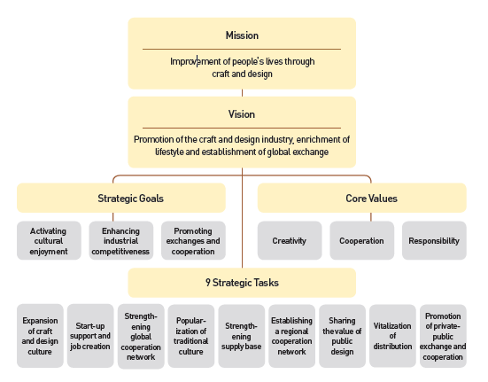
About KCDF
Home > About KCDF
미션&비전
KCDF_04_02_02_V
President Message | Establishment & History | Mission & Vision | Organization Chart
Mission
Improvement people’s lives through craft and design
Vision
Promotion of the craft and design industry. enrichment of lifestyle and establishment of global exchange
Strategic Goals
Activating cultual enjoyment
Enhancing industrial competitiveness
Promoting exchanges and cooperation
Cor Values
Creativity
Cooperation
Responsibility
9 Strategic Tasks
Expansion of craft and design culture
Start-up support and job creation
Strengthening global cooperation network
Popularization of traditional culture
Strengthening supply base
Establishing a regional cooperation network
Sharing the value of public design
Vitalization of distribution
Promotion of private public exchange and cooperation
HTML 콘텐츠
LINK & DESCRIPTION
1
2
3
4
5
6
7
8

Slide 9
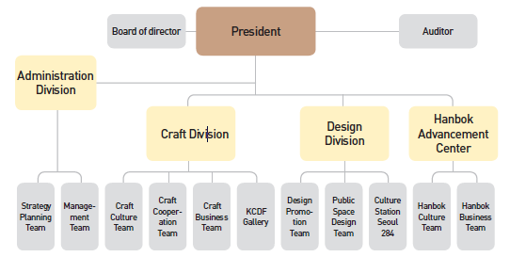
Home > About KCDF
조직현황
KCDF_04_03_V
President Message | Establishment & History | Mission & Vision | Organization Chart
HTML 콘텐츠
President
Board of director
Auditor
Administration Division
Strategy Planning Team
Management Team
Craft Division
Craft Culture Team
Craft Cooperation Team
Craft business Team
KCDF Gallery
Design Division
Design Promotion Team
Public Space Design Team
Culture Station Seoul 284
Hanbok Advancement Center
hanbok Culture Team
Hanbok Business Team
LINK & DESCRIPTION
1 | 이미지만 표시
2
3
4
5
6
7
8

